Slide 1
Cryptocurrency AI
Using LSTM to predict the price of Cryptocurrencies

Slide 2
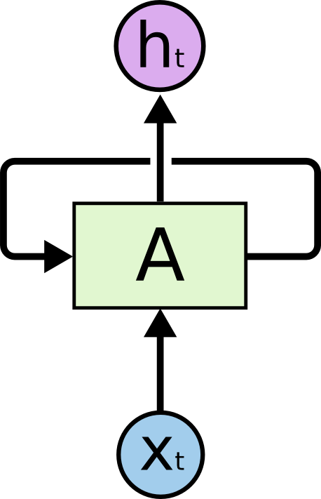
LSTM
Long Short-Term Memory
Type of RNN (Recurrent Neural Network)
Allows information to persist
Tradition RNN

Slide 3
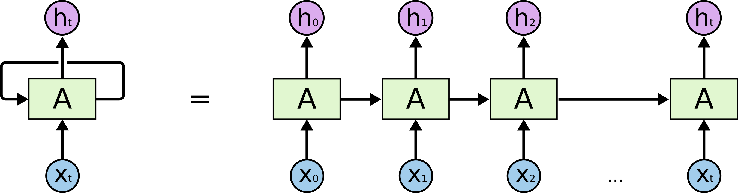
RNN
Allows for information from a node to be passed back into itself
If you want to think of it like a tradition neural network…
But there are some issues with this

Slide 4
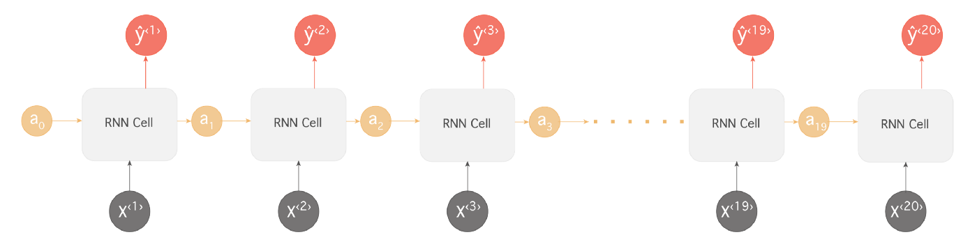
Issues with RNNs
Long-Term Dependencies
If the information we need to use for prediction is learning long from when it’s used, traditional RNN’s become less likely to be able to connect that information together. (caused by vanishing/exploding gradient problem)
In theory this shouldn’t be an issue
If a human could pick the perfect parameters for the RNN, this issue would not exist
Not practical
Notes:
Vanishing gradient = when the gradient approaches deeper levels the value approaches 0
Exploding gradient = when the gradient approaches deeper levels the value explodes past 1
If want to add “I grew up in France… I speak fluent French” in a 20 word sentence

Slide 5
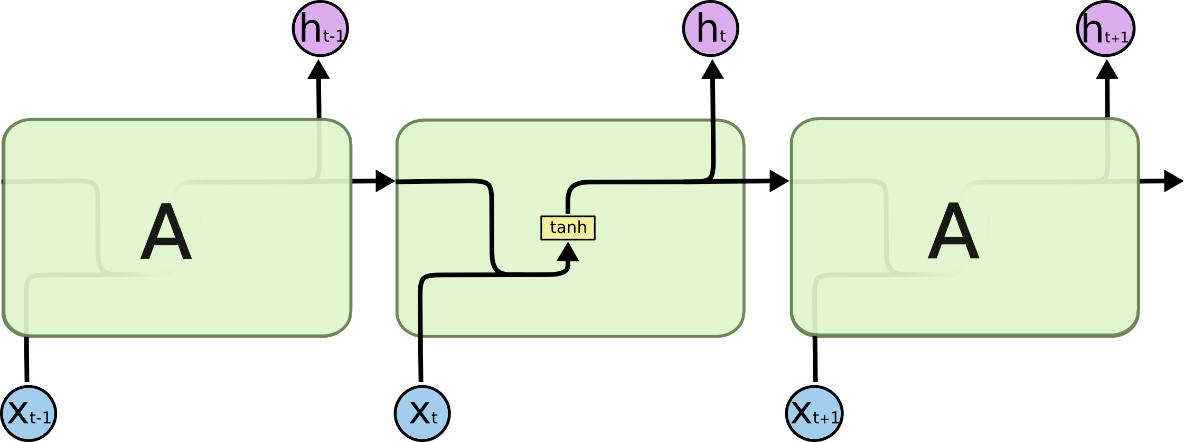

Back to LSTM
LSTMs are a specific type of RNN
Designed to avoid the Long-term dependency problem
Standard RNN
LSTM

Slide 6
LSTM
Notice the line at the top of the model
Easy to pass along info
Using the gates information can be controlled very precisely
Gates
The yellow function and a pointwise operation (pink)
The functions have a value between 0 and 1
0 meaning nothing gets through
1 meaning everything gets through

Slide 7
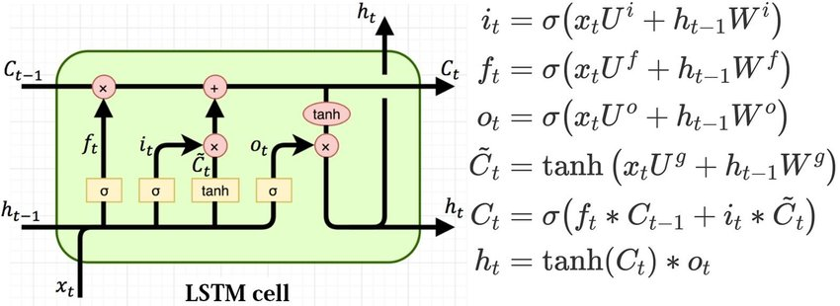


Some Math…
~
Some of the math governing a LSTM node
$h_{t−1}=Output of last LSTM node$
$x_{t}=Current input$
$C_{t−1}=Memory from the last LSTM unit$
$h_{t}=Current output$
$C_{t}=New updated memory$
$U,W=Weight Matrices$
$x=scales info$
$+ =add info$
$f_{t}=Forget Gate$
$i_{t}=Input Gate$
$o_{t}=Output Gate$
$c_{t}=Cell State$
$h_{t}=Hidden State$
$C_{t}=Candidate Values$
~
Notes:
Note: these equations can also have a “b” variable to add bias
Notes: C’t is for internal consumption of the LSTM and is used to generate ct, and ht

Slide 8
Our Research
We used LSTM to predict the price of a cryptocurrency – Ethereum
Our data was the Ethereum price from 08/07/2015 – 04/16/2020 in 1-hour intervals
Features
Close-Open
High – Low
7 Day Standard Deviation
7 Day running average
14 Day running average
21 Day running average
Labels
Next day’s closing price
Since stock fluctuates naturally, and contains many outliers within certain interval's, including averages allows for us to smooth out the data when mapping to labels.

Slide 9
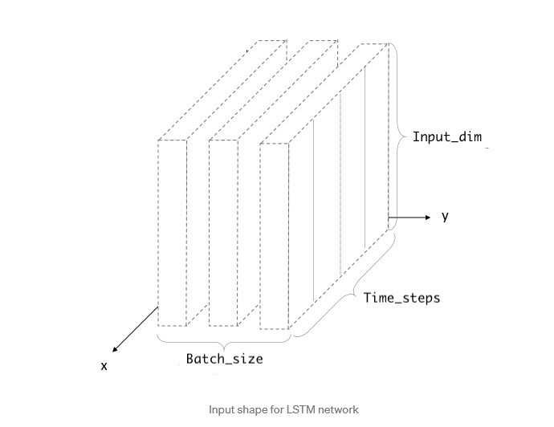
Input to Model
Input_dim = features used
Time_steps = Number of data values per batch (in our case it a batch had a day and 10 hours worth of data)
Batch_size = number of samples put into the model before weights were updated
Training – [1002, 32, 6]
Testing – [76, 32, 6]

Slide 10
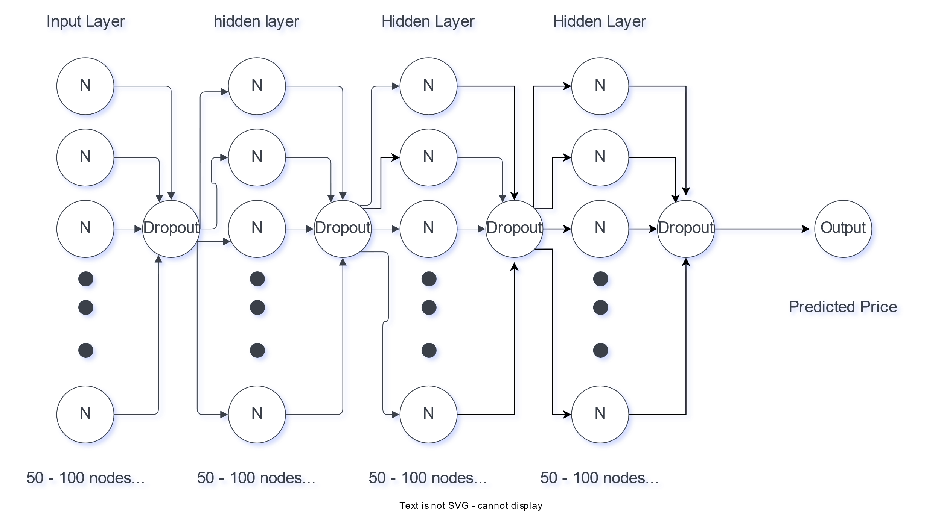
Models
Dropout: temporarily removes random units ,with their connections, based on a percentage. This is to try and prevent overfitting
Notes:
Model 1.0 does not have the dropouts
Model 1.1 does

Slide 11
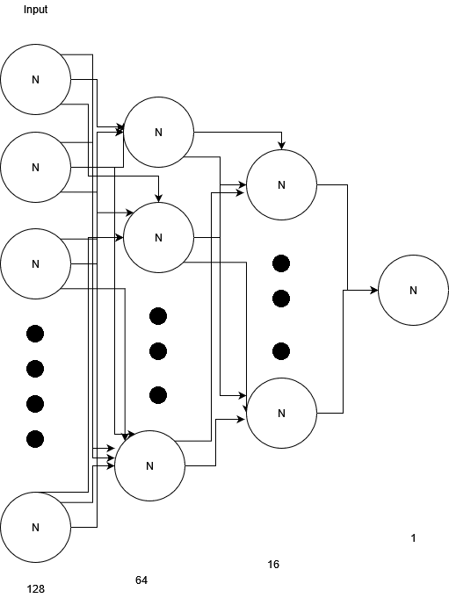
Models cont.

Slide 12
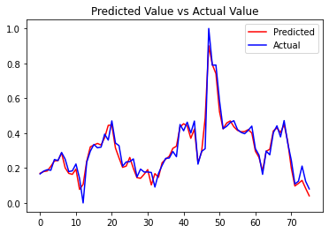

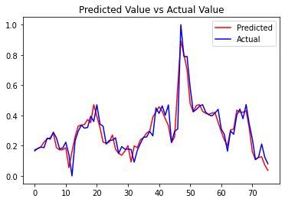
Findings
We did not find either model to be more effective than the other
We found our model to be effective
No dropout layer
With Dropout
Tapering shape

Slide 13

Code
Notes:
Outsider’s perspective our CSC

Slide 14
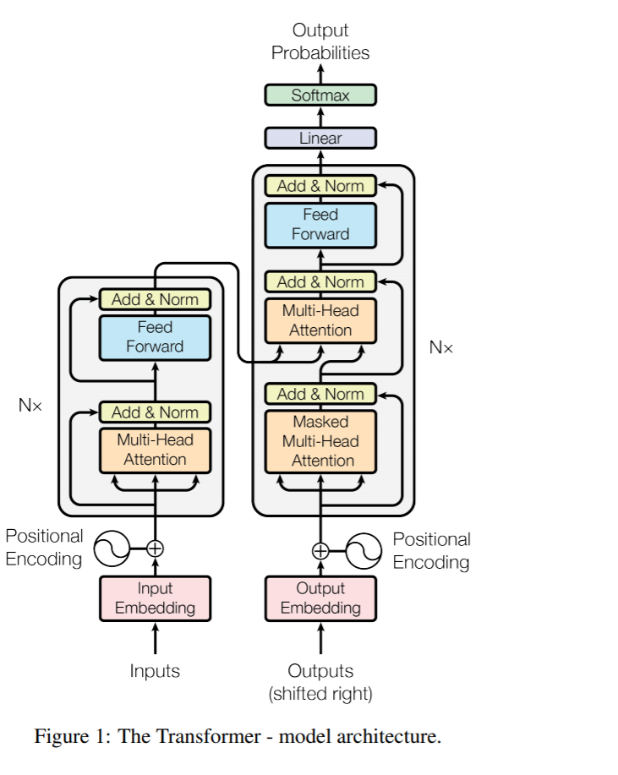
Further Research
Predictions further into the future
Applying this model to different cryptocurrencies and even stocks
Implementing a Transformer Network instead of LSTM

